Slide 1

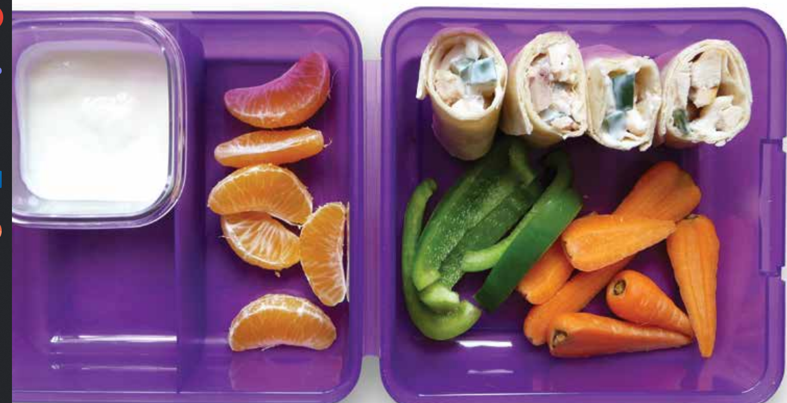

Healthy lunch box
A good variety of
different foods:
Important to ensure all the important nutrients (vitamins and minerals) are included in the diet.
Make sure the content of packed lunches is varied from day to day.
Limit sugar intake:
Children do not need sugary foods
such as sweets, biscuits, cakes
chocolate, soft drinks or sugar for
energy. Sugary foods can damage
teeth and provide calories but few
nutrients. Starchy foods – such as
potatoes, bread, rice, pasta and
yam – are better sources of energy,
as they contain other important
nutrients too. Use fruit to sweeten
yoghurts and desserts.
Young children should eat child-sized this should include portions of at least five different fruit and
vegetables a day:
Where children are reluctant to eat these you can :
Only put fruit and vegetables in their lunch box that they have tried at home
Cut fruit/ vegetable in to pieces that are easy to eat
Go shopping and let them choose a new fruit /vegetable and try together at home first
Cut up and prepare fruits and vegetables together
Offer fruits/ vegetables long with other favourite food
Let them choose what fruit/veg they put in their lunch box
Make the contents colourful and appetising
DRINK
Serve water with the packed lunches
Choose good-quality food:
Young children need to eat small
quantities of good food regularly. The
best foods are those that are minimally
processed and which have been made
from good-quality ingredients. Avoid
foods that are ‘diluted’ – for example,
processed meat or fish covered with
breadcrumbs, batter or other coatings
(such as sausage rolls, Scotch eggs, chicken nuggets or fish cakes) which make them lower in nutrients.
Good sources of iron and
Zinc:
Should be served at main
meals. This includes meat, fish, eggs,
ground nuts and seeds, and soya
products such as tofu.
For Further information, advise and tips speak to a member of staff or contact us
Email earlysupporthub@harrow.gov.uk

